Slide 1
Advanced Techniques with Large Language Models Lecture 6
Northeastern University
College of Engineering
Multidisciplinary Graduate Engineering Department
INFO 6105 – Fall 2024
Instructor: Abdolreza Mosaddegh

Slide 2
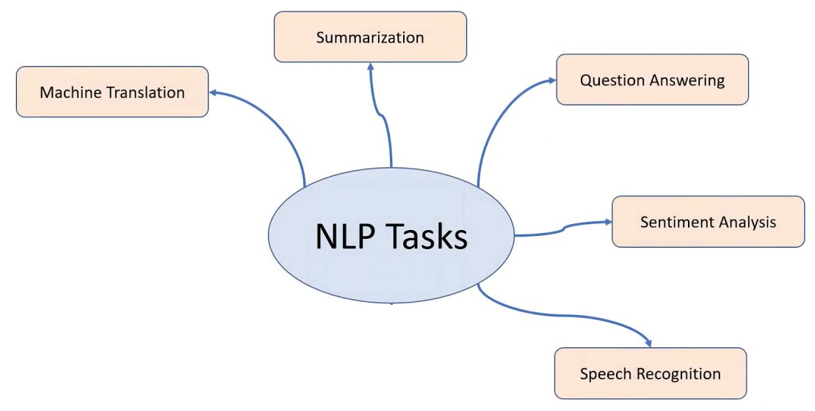
Neural Networks for NLP
Words should be converted to numbers for processing by neural networks
Use word embeddings (vectors) for representing words by numbers
These embeddings encode meanings of the words
We need neural networks which can process a sequence of embeddings for NLP tasks

Slide 3
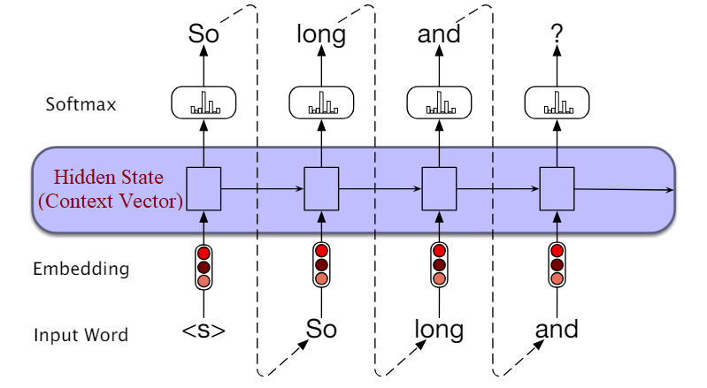
Recurrent Neural Network
Recurrent Neural Networks (RNNs)
Recurrent neural networks designed to process sequences of inputs and can produce sequences of outputs
RNNs maintain a recurrent connection that allows them to store and update a hidden state, acting as a memory of previous inputs (context)

Slide 4
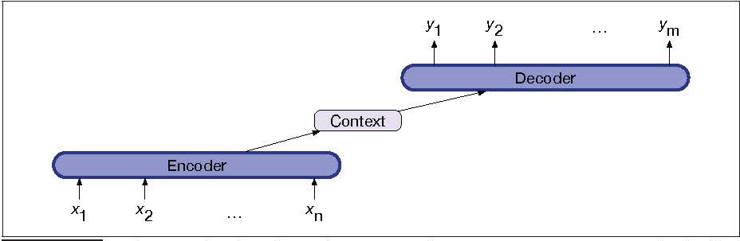
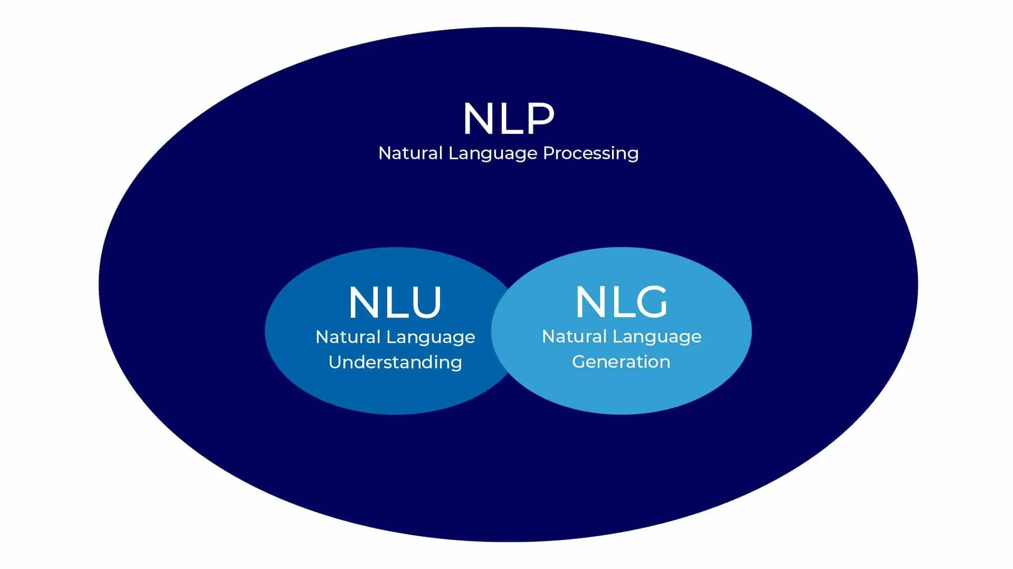
Encoder and Decoder (Seq2Seq)
Encoder models are generally used to understand input sentences, and decoder models are generally used to generate sentences.
An encoder that accepts an input sequence and generates a context vector, conveys the essence of the input to the decoder (NLU).
A decoder, which accepts context as input and generates an arbitrary length sequence of outputs (NLG).

Slide 5
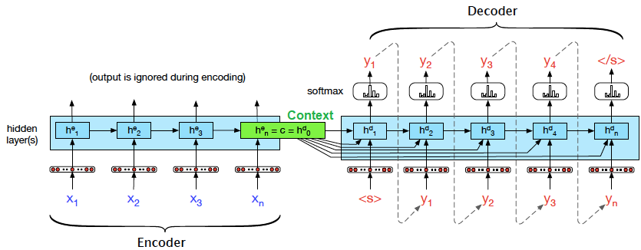
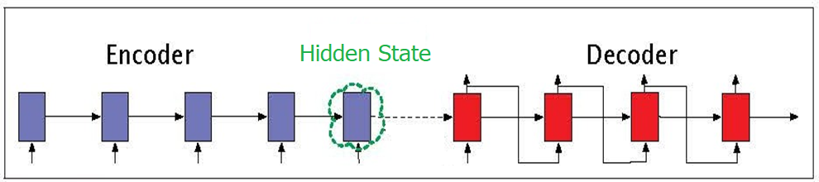
Encoder‐Decoder – Long Memory Challenge
The influence of the context vector, will wane as the output sequence is generated (only short-term memory).
A solution is to make the context vector available at each step in the decoding
Long term memory is needed to represent the context of the source text
Short term memory is needed to represent of previous words in target language
LSTM architecture also provides both long term and short term memories

Slide 6
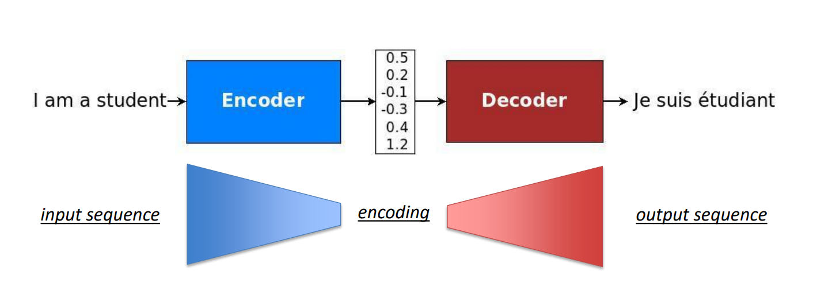
Bottle Neck in Seq2Seq Models
Challenge:
All the context gets compressed in one vector (hidden state) might lose information
The same context from encoder is fed to all nodes in decoder
Solution: attention mechanism
Different parts of a sequence in encoder attending on relevant parts of a sequence in decoder
Hidden State
(Latent Vector)

Slide 7
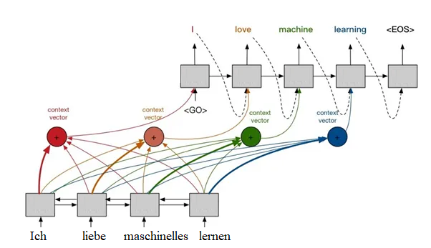
Seq2Seq with Attention
Use encoder/decoder architectures based on RNNs / LSTM
Use encoder/decoder attention mechanisms
Seq2Seq RNNs with attention were a significant improvement over traditional RNNs for tasks like machine translation

Slide 8
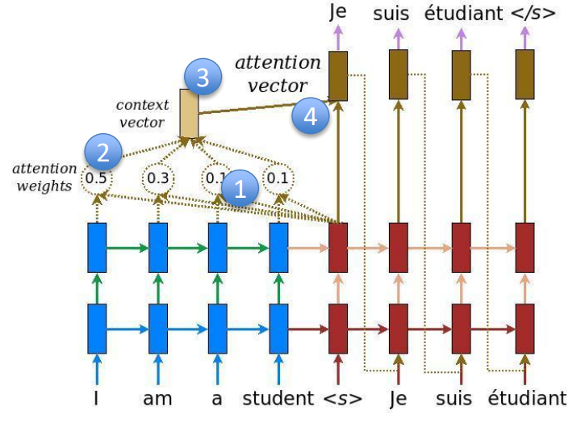
Problem with seq2seq even with Attention
Long-Range Dependencies:
RNNs struggle with capturing long-range dependencies because information has to pass through many intermediate steps.
Sequential Processing :
Limited scalability due to their sequential nature and the challenges in parallelizing their computations.
The hidden states in RNNs depend heavily on the order of the sequence.
The attention mechanism is still dependent on the sequential nature of RNNs.

Slide 9
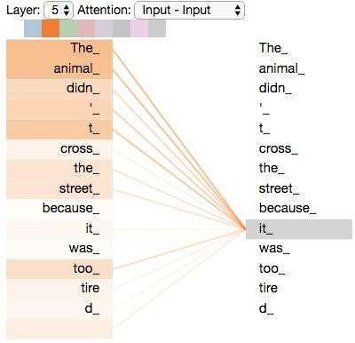
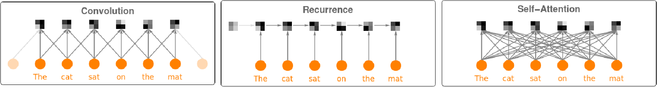
Self-Attention
Every token can attend to every other token, which makes it great for capturing long-range dependencies.
Self-attention allows for parallel computation across all tokens in a sequence.
Unlike RNNs this attention is not between encoder and decoder (just encoder side), so it is called self-attention
It is primarily used in transformer models which are very effective for NLP tasks and beyond.

Slide 10
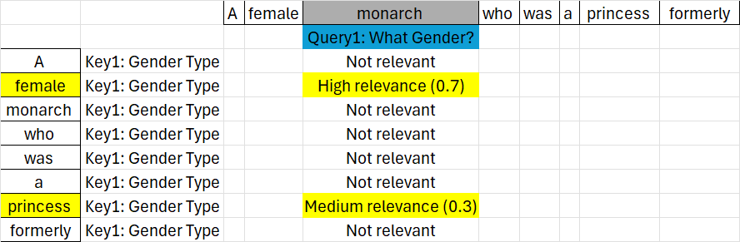
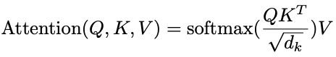
Single-Head Attention
To extract words’ semantic meaning a set of queries is used
Keys presents relevance of words to queries
Values transform the embedding of target word by embedding of relevant words
A single head may focus only on specific relationships or features in the input, potentially missing out on other aspects.

Slide 11
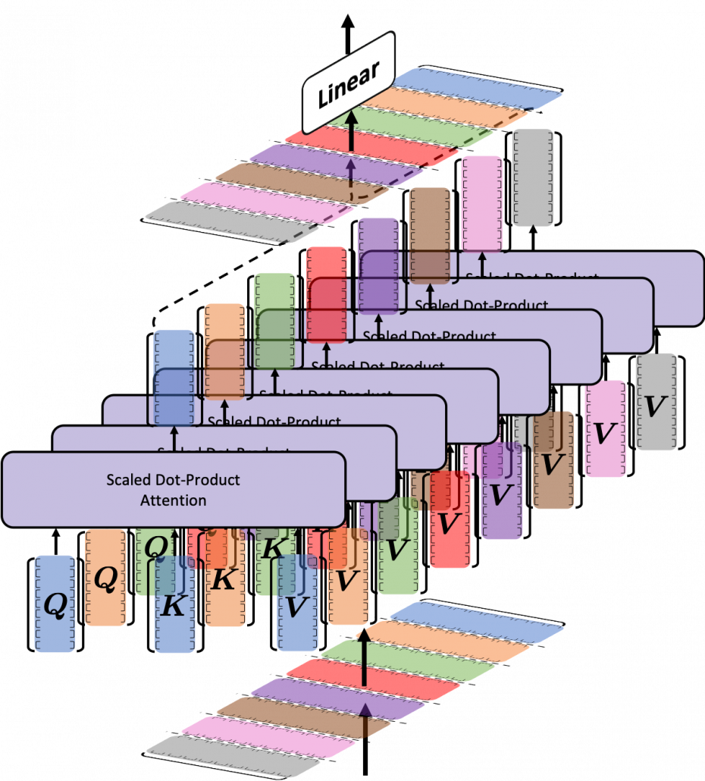
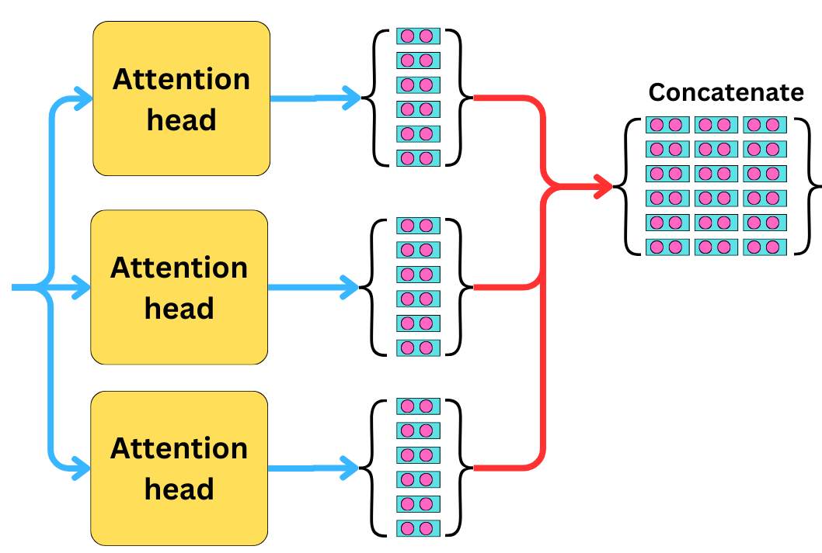
Improvement - Multi-headed Attention
Capturing different aspects of context can be done multiple times in parallel
Each head a different set of Q, K, and V vectors
Each head is focused on one specific aspect (syntactic, semantic, etc.)
Each head processes a subset of dimensions which improve efficiency
Can be executed in parallel
GPT3:
dimensions ​ = 12288 (input embedding size),
heads = 96,
𝑑𝑘= dimensions /ℎeads = 128 (embedding size per head).
Embedding

Slide 12
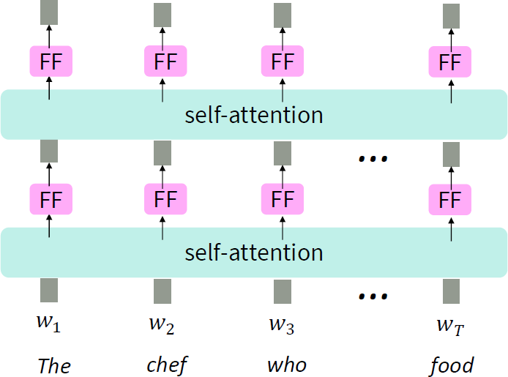
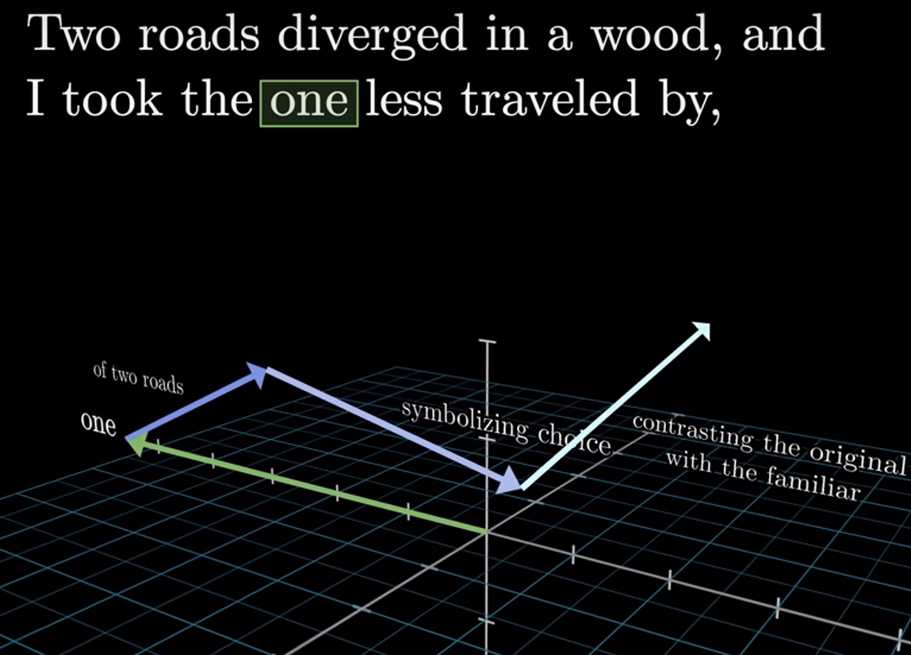
Improvement - Multi-layer Attention
Stacking multiple layers (Multi-layer Attention) allows the model to build a hierarchical understanding of the text
Early layers focus on simple and syntactic relationships, while deeper layers capture higher-level semantics and more complex and abstract relations
GPT 3 has 96 attention layers
One refers to road

Slide 13
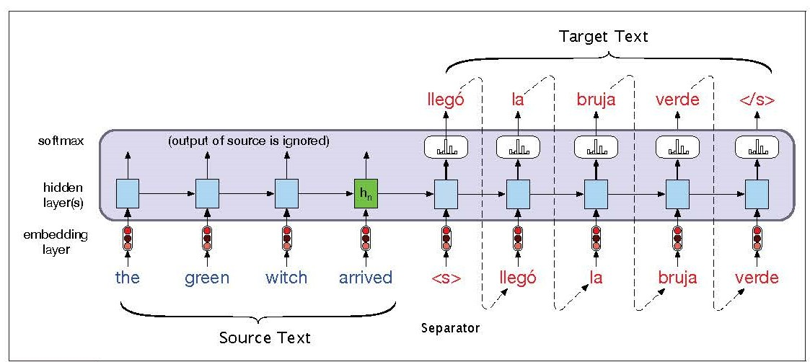
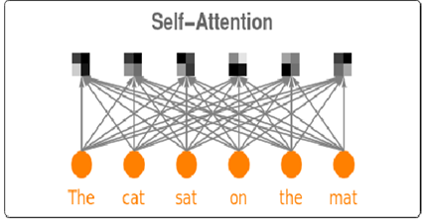
Problems of Self-Attention for NLP
Sequential Tasks in NLP
Self-Attention is order-invariant
Order is important in many NLP tasks (e.g., text generation)
Lack of non-linearities
In Self-Attention linear combination of other embeddings attends in each embedding
Most real-world relations are non-linear
Autoregressive text generation
In generation tasks in decoder (e.g., text generation), the model doesn’t look at the future parts of a sequence, but self-attention requires the entire sequence

Slide 14
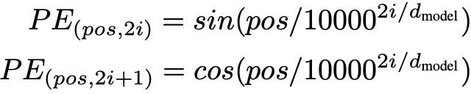
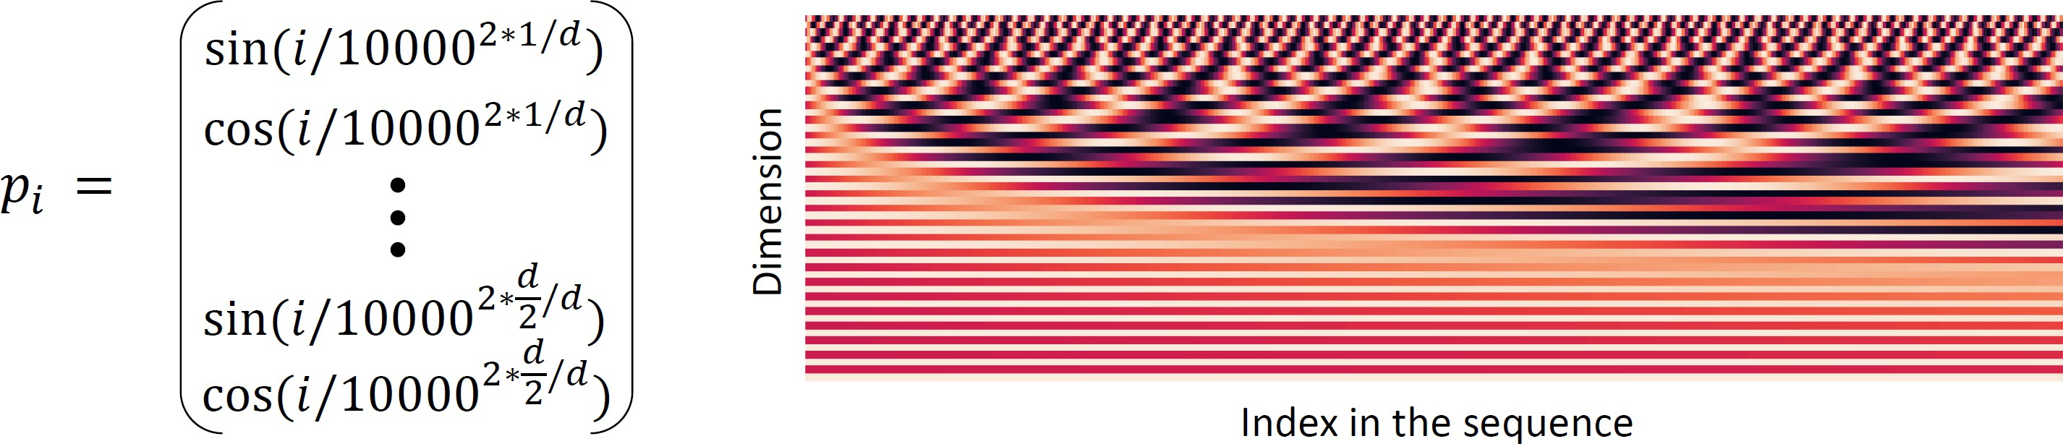
Positional Encoding
Positional Embedding: Vector that represents position of each token
Need for information about the position and order of tokens in a sequence
Adding position to Attention Mechanism
Addition the position embedding to the word embedding vector
Position embeddings can be fixed (e.g., Sine or Cosine functions) or learnable
Sinusoidal position representation

Slide 15
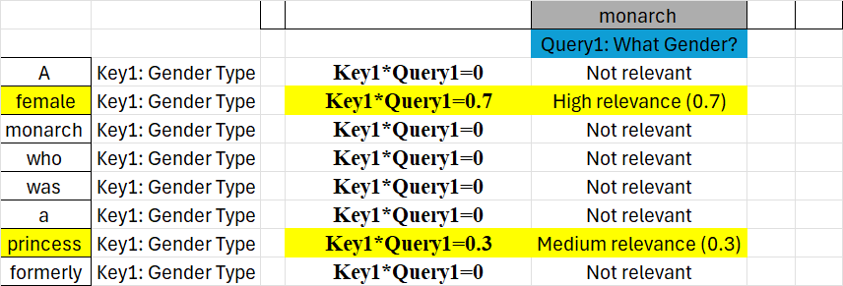
Combine Self-Attention with Nonlinearity
Vanilla self-attention
In Self-Attention linear combination of other embeddings attends in each embedding
Most real-world relations are non-linear
Solution:
Add a Feed Forward Neural Network contains non-linear activation function
E(monarch) ← E(monarch) + 0.7 V(female) + 0.3V(princess)
Each FF typically consists of two fully connected layers:
FFN(x)=ReLU(xW1+b1)W2+b2

Slide 16
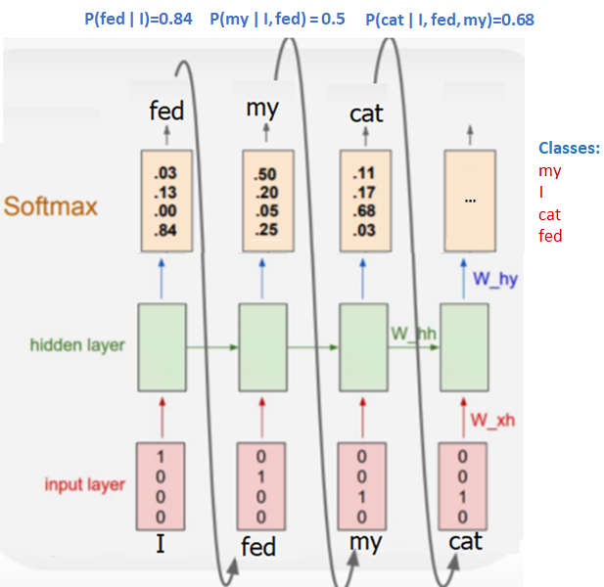
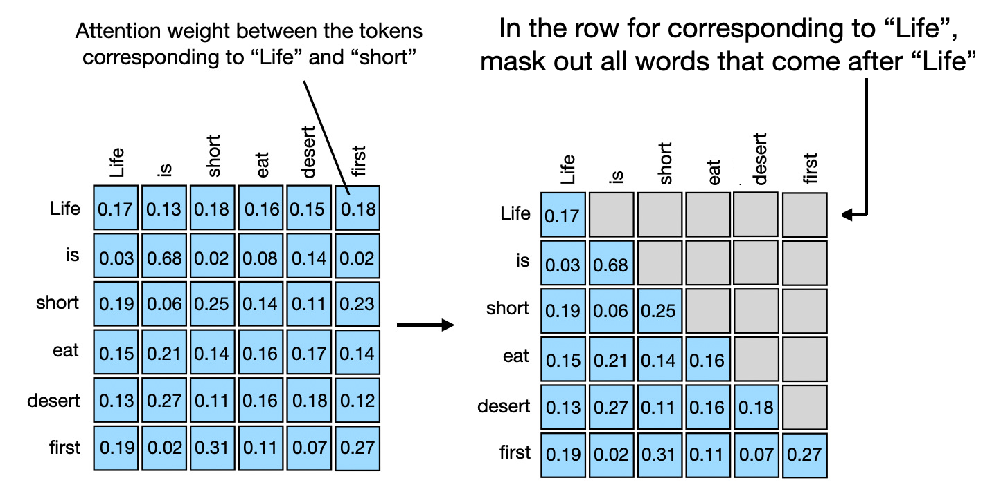
Masked Attention
In autoregressive text generation, the decoder model generates one token at a time by considering previous tokens. The model should not "look ahead" at future tokens when making predictions about the current token:
A mask is applied to the attention mechanism, ensuring that the model only attends to previous tokens, but not any future ones.
These positions corresponding to future tokens usually are set to a very low value, preventing the model from attending to them.

Slide 17
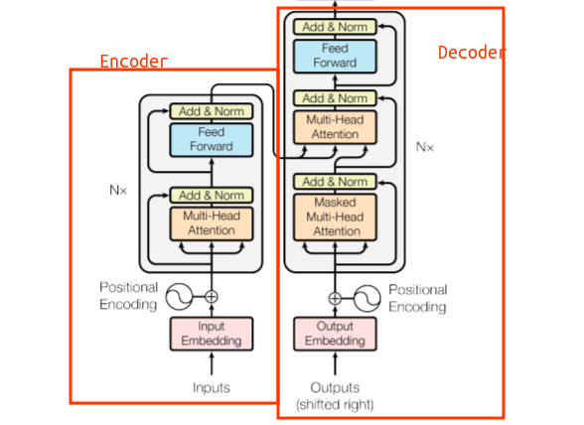
A Transformer Architecture
The Transformer architecture is a deep learning model
It introduced in the paper “Attention is All You Need” (Vaswani et al. in 2017).
It revolutionized natural language processing (NLP) tasks
It uses various attention mechanisms

Slide 18
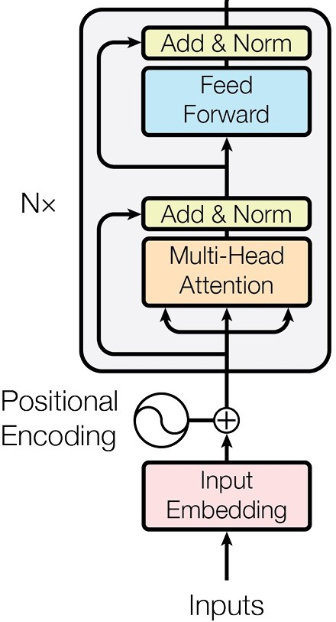
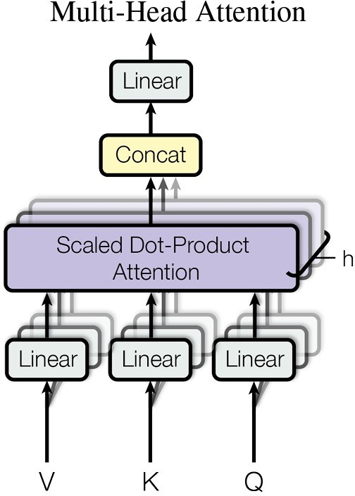
Encoder Model
1. Self-attention mechanism is used to encodes context
2. Feedforward network is used to provide non-linearity
3. Residual connections and normalization
Multi-head attention blocks capture information from different subspaces at different positions
It is possible to stack many multi-head attention blocks and FF layers one after each other

Slide 19
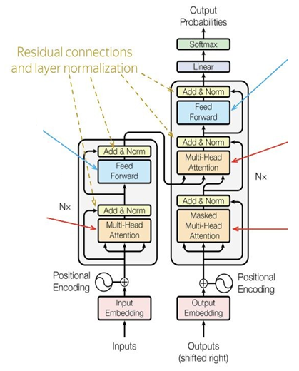
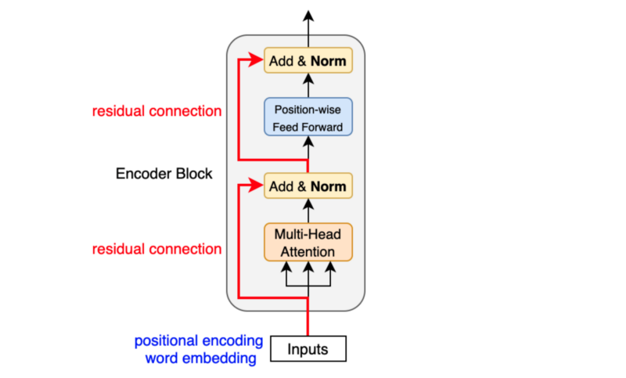
Add & Norm Layer
Original input of the attention layer (residual connection) is added to the attention output
Helps in preserving the original information while incorporating the context using attention
This sum is then passed through a layer normalization step, which helps in stabilizing the training by normalizing the input to have zero mean and unit variance.

Slide 20
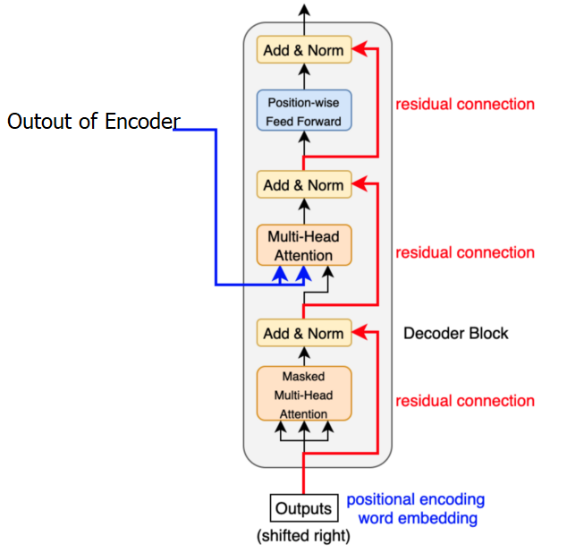
Decoder Model
For generation tasks, mask attention mechanism is used
Cross attention is used to receive the context from encoder side

Slide 21
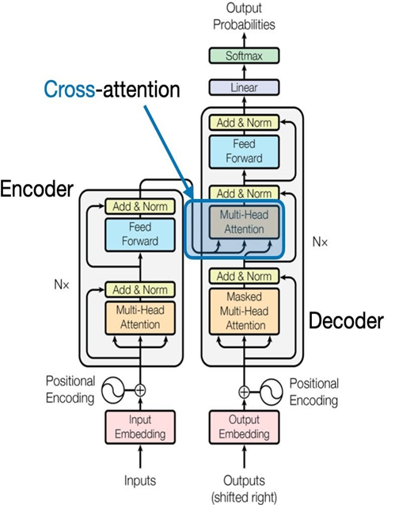
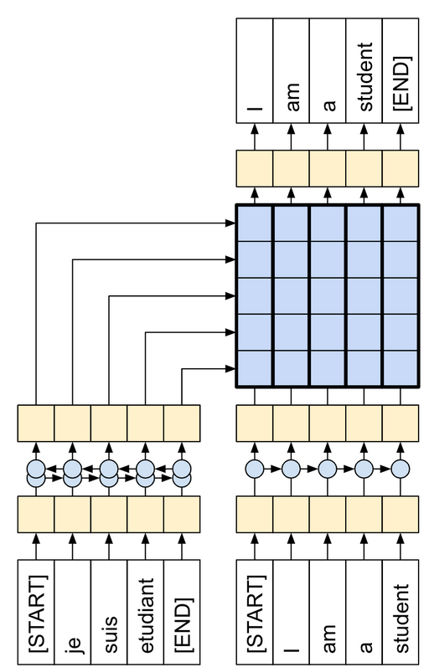
Cross attention
In self-attention and masked attention, the model focuses on different parts of a single sequence.
Cross attention involves two sequences, where the model attends to elements in decoder side sequence based on information from encoder side sequence
Cross-Attention required for tasks like translation, where the model needs to align words in a source sentence with words in a target sentence.
The decoder takes the encoded context of the source words (e.g., in source language) and uses it to generate or modify the target words (e.g., in target language)

Slide 22
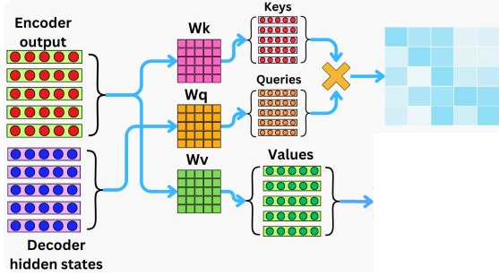
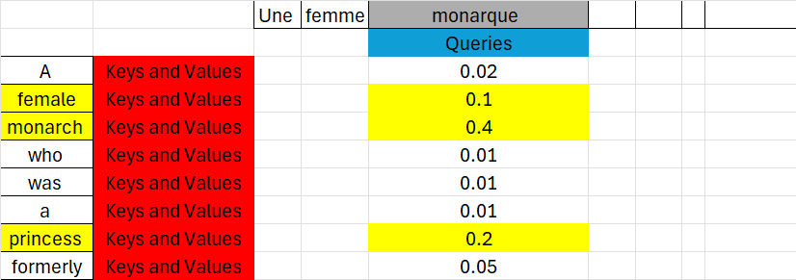
Cross attention
Cross-attention is used when a transformer is processing information from one sequence while attending to another sequence
The queries come from the target sequence (e.g. context of previous generated words in target language)
The keys and values both come from the input sequence (e.g., context of sentence in source language)

Slide 23
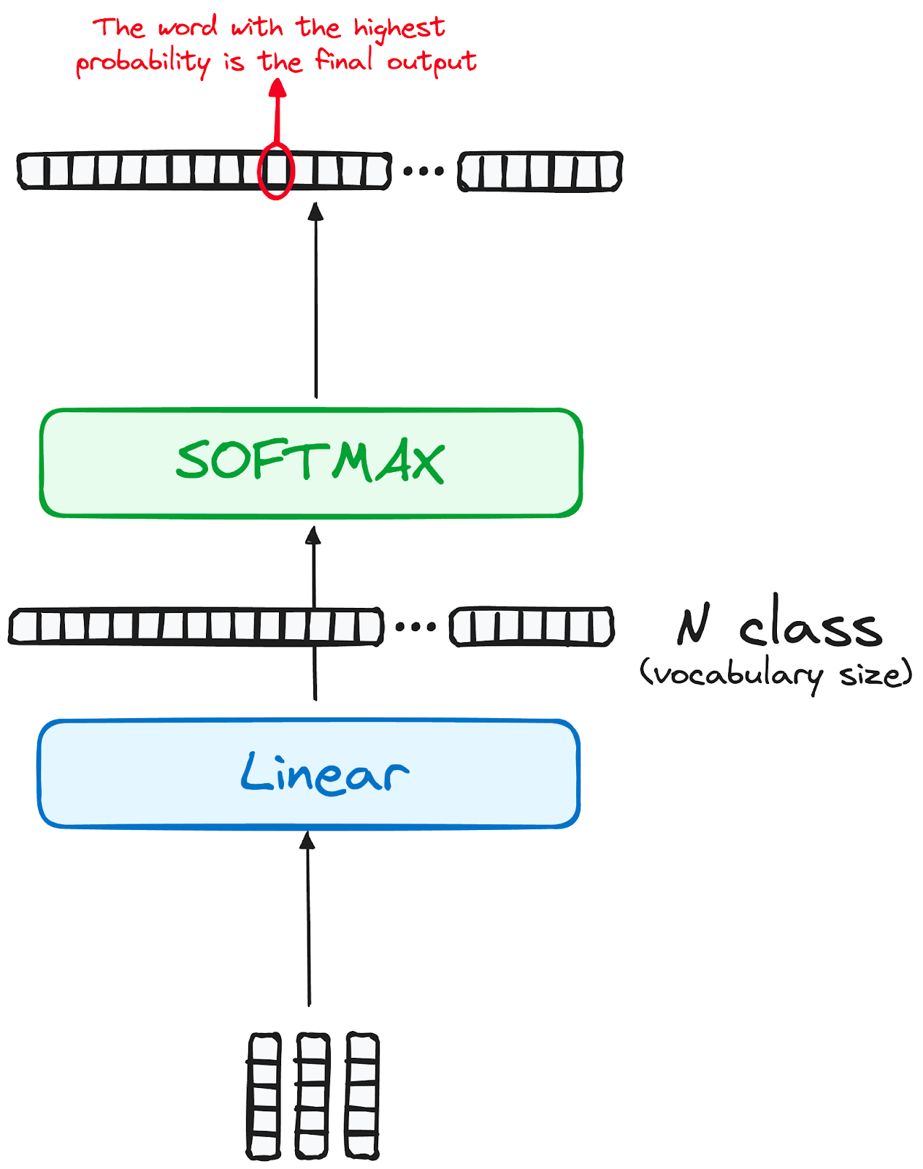
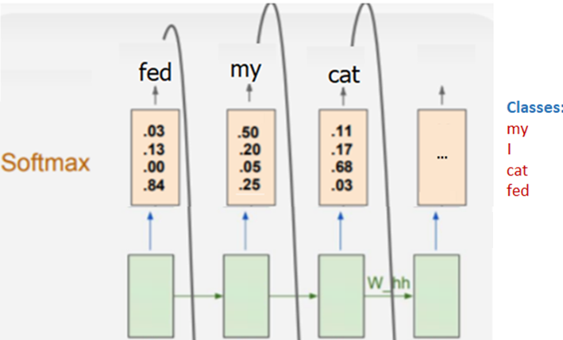
Linear Layer and Softmax
The linear layer transforms output vector into a vector of size equal to the vocabulary size.
This transformation is needed because the final output needs to represent probabilities over all possible words in the vocabulary.
The softmax function converts this vector (logits) into probabilities by normalizing them across all vocabulary items.

Slide 24
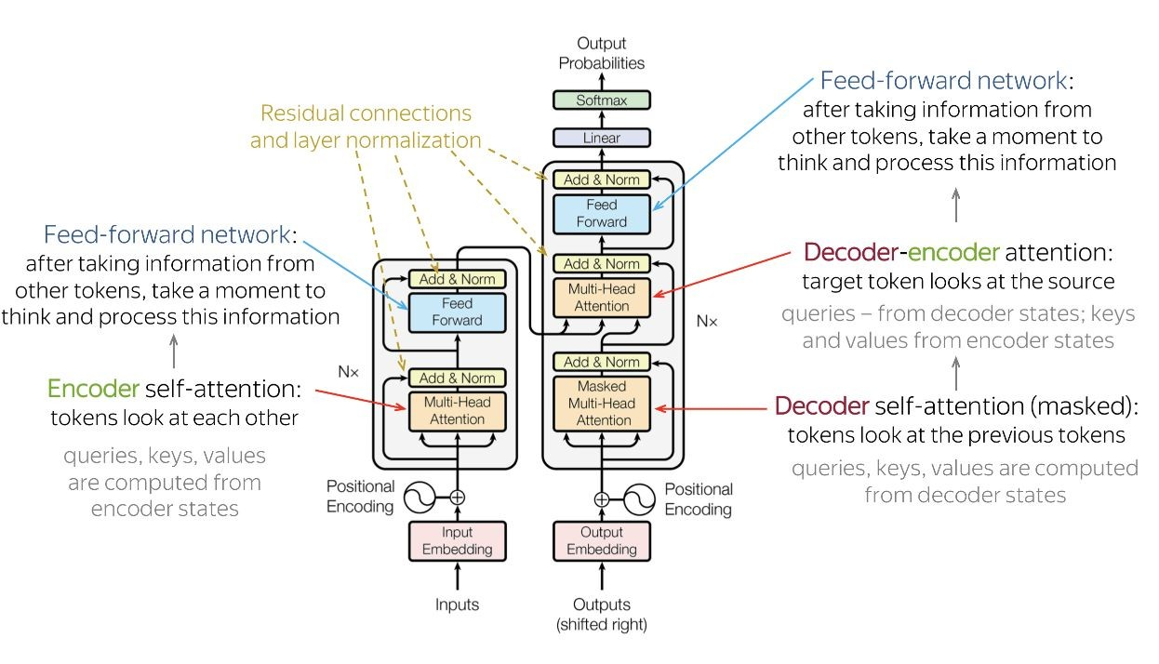
Transformer Model Architecture
Word Embedding
Positional Embedding

Slide 25
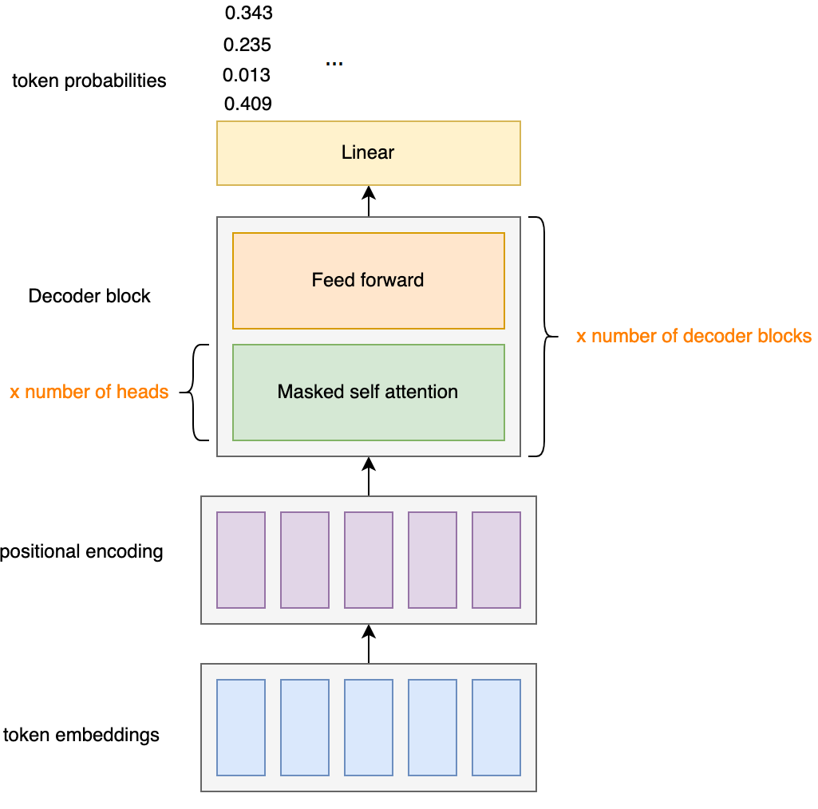
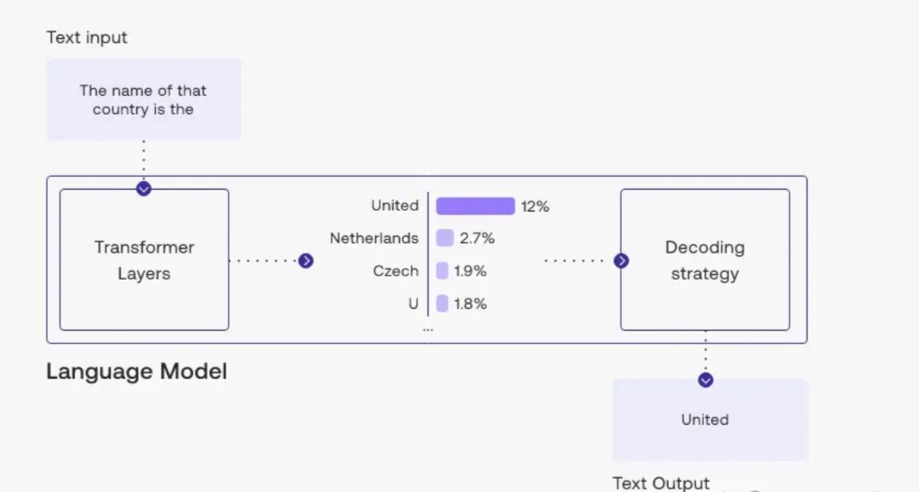
Text Generation
LLMs do not directly produce text.
LLMs calculate scores assigned to every possible token in their vocabulary.
There should be a decoding strategy to choose best choice

Slide 26
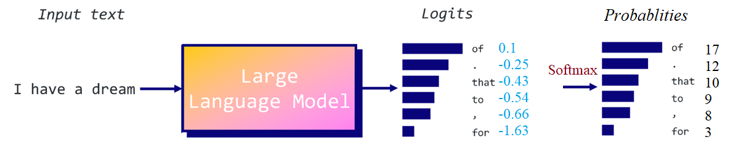
Decoding Strategy
Decoding strategies are methods used to generate a sequence of text from a trained model:
Transformers predict the next word based on the previous words, but they don’t necessarily optimize for the quality of the entire sentence or paragraph.
Text generation needs to consider syntactic and semantic structure (coherence)
Also, different tasks need different levels of creativity in the output (e.g., translation needs accuracy, story writing needs creativity)
P(of ∣ I have a dream)=%17

Slide 27
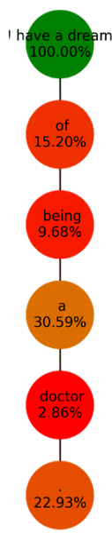
Decoding Strategy - Greedy Search
Takes the most probable token at each step.
It doesn’t consider the overall effect on the sequence.
It's fast, but it is short-sighted.
Step 1: Input: “I have a dream” → Most likely token: ” of”
Step 2: Input: “I have a dream of” → Most likely token: ” being”
Step 3: Input: “I have a dream of being” → Most likely token: ” a”
Step 4: Input: “I have a dream of being a” → Most likely token: ” doctor”
Step 5: Input: “I have a dream of being a doctor” → Most likely token: “.”

Slide 28
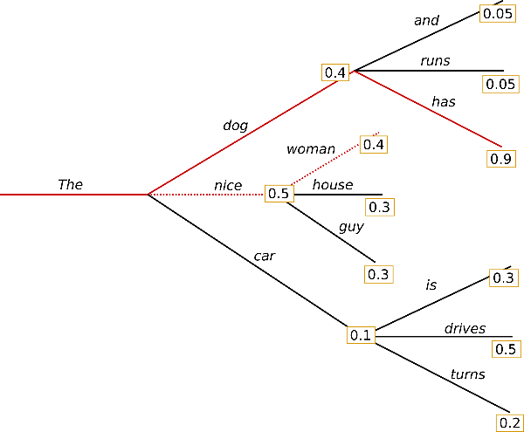
Decoding Strategy - Beam Search
Considering the N most likely (Beam Width) tokens at each step.
The procedure repeats until you hit a maximum length or an end-of-sequence token.
This will create a tree structure, where each node will have N children.
It selects best sequence
Beam Width=3

Slide 29
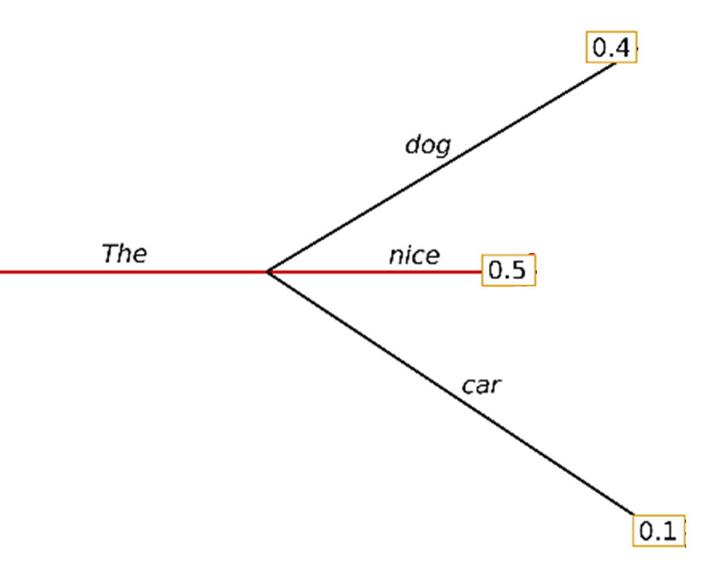
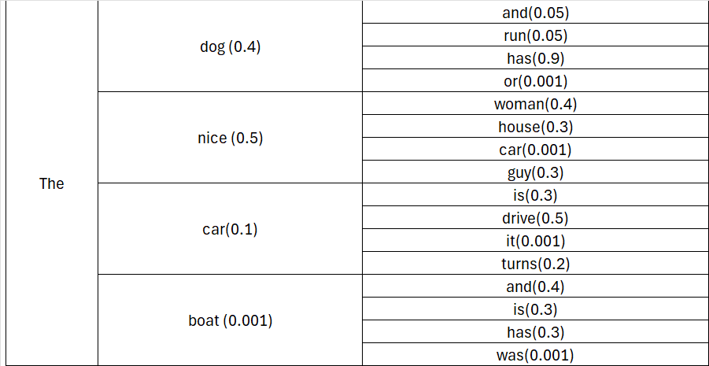
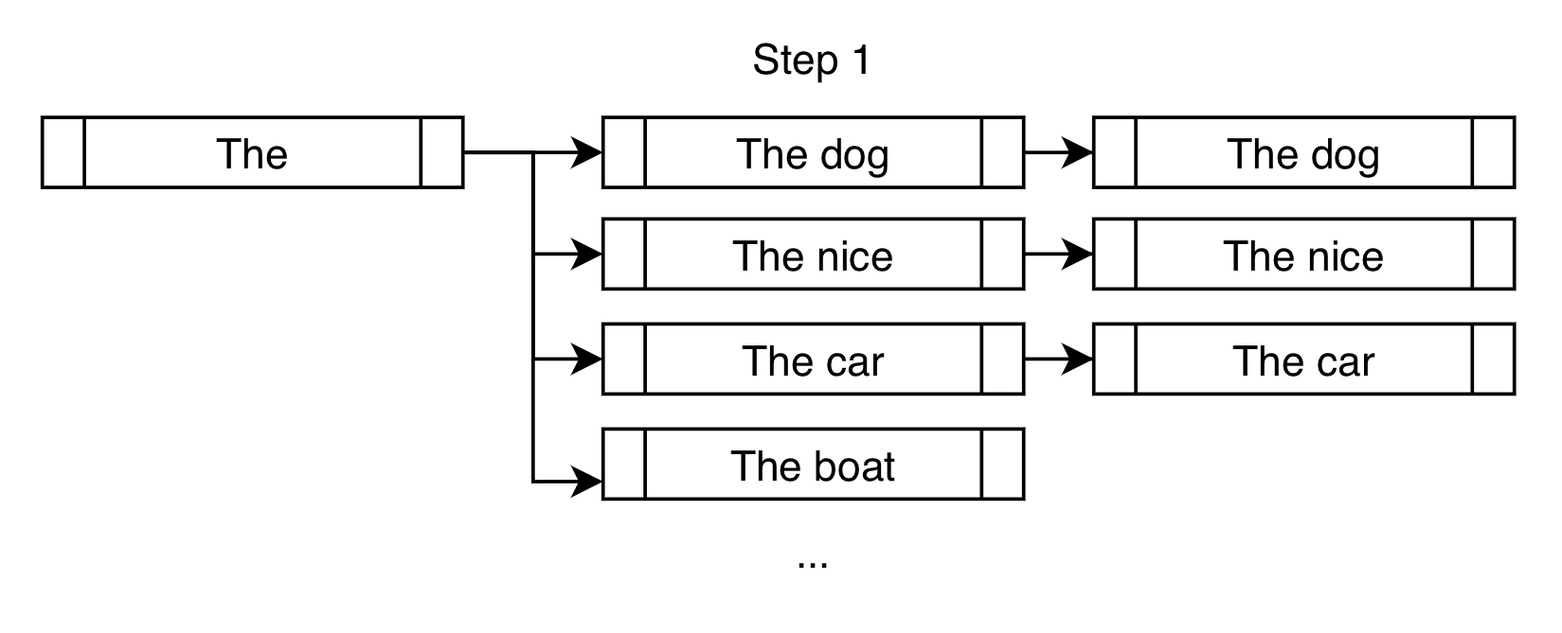
Beam Search – Tree Structure
Identify N tokens with the highest sequence score
Beam Width=3

Slide 30
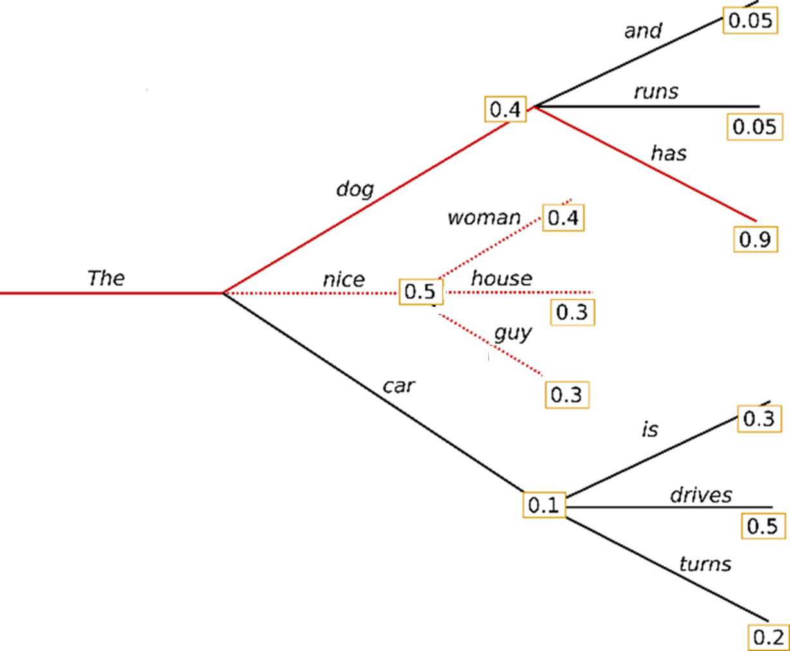
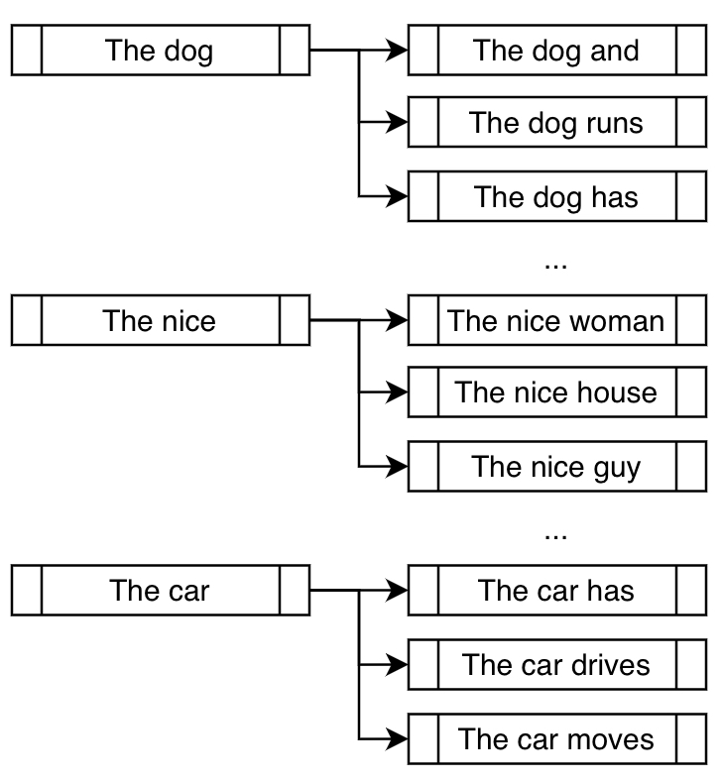
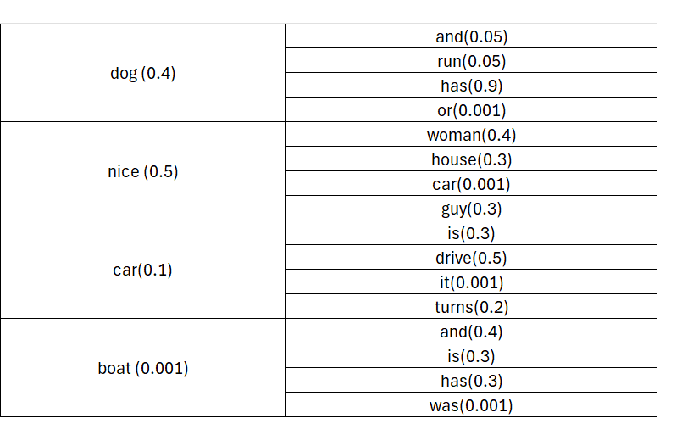
Beam Search – Tree Structure
Beam search might stop when a certain percentage of beams reach the end token or after a fixed number of steps.
Beam Width=3
Number of Steps = 2

Slide 31
Beam Search - Best Sequence
Identify the path with the highest sequence score
p("The","dog",“and")= 0.4 * 0.05 = 0.02
p("The","dog",“runs")= 0.4 * 0.9 = 0. 02
p("The","dog","has")= 0.4 * 0.9 = 0.36
p("The",“nice",“woman")= 0.5 * 0.4 = 0.20
…
Sequence ("The","dog","has"), with 0.36 has the highest probability

Slide 32
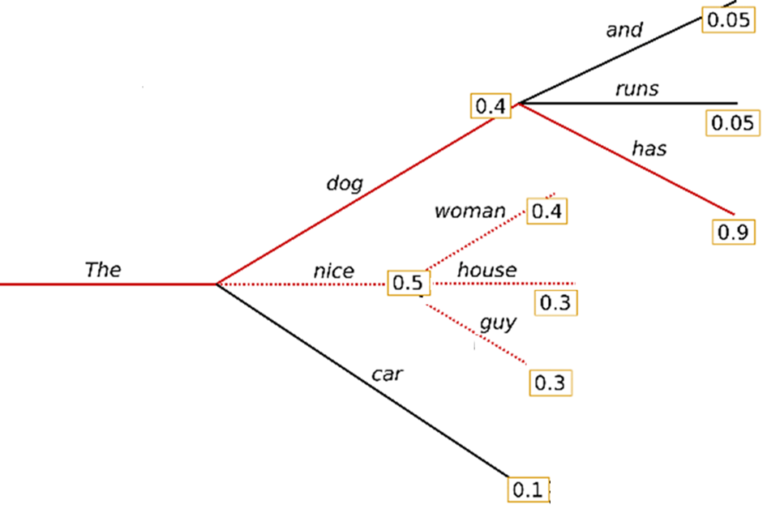
Beam Search - Pruning
By branching out, number of branches will be beam-width^n for n steps (beam-with of 4 after 10 steps is 1,048,576 paths).
Pruning involves discarding sequences that have low probabilities, which are unlikely to lead to optimal solutions.
Pruning aggressively might discard some sequences that could lead to a good final output, but careful threshold tuning can mitigate this.
Pruning Threshold = 0.12

Slide 33
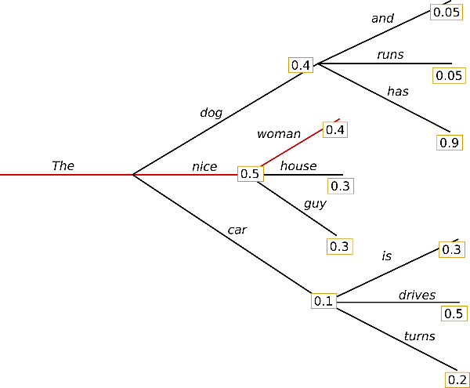
Greedy vs Beam
Greedy search selects the highest-probability token at each step, this is fast but can lead to suboptimal sequences.
Beam search mitigates this by considering multiple candidates, increasing the chance of finding a more optimal sequence.
Result of Beam Search
Result of Greedy Search

Slide 34

Decoding Strategy - Top-k Sampling
Select a token randomly from the k most likely options.
This approach ensures that we prioritize the most probable tokens while introducing an element of randomness in the selection process.
Randomness allows for more diversity and creativity
Example:
P(park)=35%, P(store)=30%, P(grocery)=10% and P(beach)=5%, P(restaurant)=4 %, …
In top-4 sampling, “restaurant” is disregarded, and the algorithm will output:
park 35/80 = 44% of the time, store 30/80=37% of the time, etc.

Slide 35


Temperature
Another way of introducing randomness is the concept of temperature.
The temperature is a parameter that ranges from 0 to 1
It affects the probabilities generated by the softmax function, making the most likely tokens more influential.
Impact of temperature on the probabilities generated for a given set of input logits [1.5, -1.8, 0.9, -3.2].

Slide 36

Temperature Value
A temperature of 1.0 is equivalent to a default softmax with no temperature which gives most probable token
A low temperature (e.g., 0.1) sharpens the differences between probabilities (less chance for smaller probabilities and less diversity)
A high temperature (e.g., 1.5) flattens out the differences between probabilities (more chance for smaller probabilities and more diversity)
By adjusting the temperature, we can influence the extent to which the model produces more creative (diverse) or predictable responses.

Slide 37

Temperature - Impact
At higher temperatures, we see more hallucinations and lower quality of responses on average, but also more creative and diverse responses
Frequency and presence penalties can also add diversity by penalizing the reuse of tokens that have already occurred in the text.

Slide 38



Beam Search with Top K
Higher scores do not always lead to more realistic or meaningful sequences.
Instead of selecting the highest-probability tokens (as in regular beam search), use Top-k sampling.
The sampling, making more diverse choices.
Beam-width = 2
(two random
from top 4)
Top-4 sampling

Slide 39

Decoding Strategy - Nucleus Sampling
Nucleus sampling( top-p sampling), picks top probable tokens until the total probability surpasses the threshold p.
Unlike top-k sampling, the number of tokens included in the nucleus can vary from step to step.
Better than top-k in selecting important tokens
We can also use the “nucleus” parameter in the beam search.

Slide 40

Nucleus - Example
Set the value of p to 0.92
Include a minimum number of tokens satisfies the threshold (p)
In the first example, this included the 9 most likely words, whereas it only has to pick the top 3 words in the second example to exceed 92%.

Slide 41

Choosing Suitable Strategy
Main decoding strategies for LLMs: - Greedy search - Beam search To add variability and creativity to beam search: - Top-k sampling - Nucleus sampling
Both top-k and nucleus sampling offer advantages when generating text, enhancing diversity, and introducing creativity into the output.
Choice between the methods depends on the specific requirements and constraints of tasks/projects.

Slide 42

Foundation Models
Foundation models are large-scale, general-purpose pre-trained models that serve as a base (foundation) for various tasks across multiple domains.
The general knowledge learned through pre-training transfer well to various tasks (Transfer-Learning) with minimal task-specific fine-tuning
humanloop

Slide 43

Why Foundation Models
Efficiency:
Training large models on huge datasets is computationally expensive, but once trained, these models can be fine-tuned to a wide range of downstream tasks with relatively small amounts of additional data
Universal Applicability:
Foundation models can generalize across tasks and domains, reducing the need to build and train separate models for each task.
Multimodal Capabilities:
Some foundation models, like CLIP and DALL-E, have bridged the gap between different types of data, enabling more complex interactions between text, images, and potentially other modalities.
Bommasani et al

Slide 44

GPT Series of Models
GPT: Generative Pre-trained Transformer
A transformer model architecture
stack of transformer decoder layers
Goal: generate text
GPT is a commercial LLM from OpenAI
GPT Pre-training:
GPT series are pre-trained on a large corpus of text from the internet, and data licensed from third-party providers(in GPT4) learning to predict the next word in a sentence.
After pre-training, it became capable of generating text that mimics human writing, performing tasks like translation, summarization, and question answering, even without task-specific fine-tuning.

Slide 45

GPT3 Layers
Self-Attention Mechanism:
The number of attention heads is 96.
The number of attention layers is 96.
175 billion parameters
Dimensions of each attention head is 128, which means that the total attention head size per layer is 96×128=12,288 (size of embedding)
Feed-Forward Network:
The feed-forward network inside each layer consists of two fully connected layers and Relu activation function: Output=(ReLU(xW1​+b1​))W2​+b2​
The hidden layer for the feed-forward network is 4 times the embedding size, so it has a dimension of 12,288×4=49,152
Layer Norms:
Each transformer layer contains layer normalization layers

Slide 46

How GPT Translates Without an Encoder?
GPT models are pre-trained on massive amounts of text data, which includes multi-lingual text and natural translations from one language to another.
During training, they learn to generate coherent text, understand context, and pick up on the patterns and relationships between different languages.
GPT dynamically builds a hidden state that captures the meaning of the source text, and this hidden state is used to generate the translation.
While GPT can perform translation tasks reasonably well, it may not always be as accurate or consistent as dedicated encoder-decoder translation models like MarianMT or Google’s T5 with long and complex sentences

Slide 47

BERT
BERT : Bidirectional Encoder Representations from Transformers
A transformer model architecture
Stack of transformer encoder layers
Goal: Understanding context
BERT is an open source LLM from Google
BERT Pre-training:
BERT is pre-trained on large amounts of Wikipedia + BooksCorpus.
BERT present high performance on a variety of NLP benchmarks including question answering, translation, etc.

Slide 48


BERT Model Architecture
Multi-layer Transformer encoder model
Bert-base: 12 layers, 12 attention heads, 110M parameters
Bert-large: 24 layers, 16 attention heads, 340M parameters
Bidirectional: each token can attend to its left and right context for self-attention
WordPiece embedding (segment + positional + token embeddings)

Slide 49
BERT Limitations
Not Generative
BERT is not suited for text generation tasks (not decoder model).
Fixed Context Length
BERT is trained with a maximum sequence length (commonly 512 tokens), which can limit its performance on tasks involving long documents.
Computational Costs
BERT’s large model size and bidirectional training come with high computational costs, both in terms of memory and processing power. Fine-tuning BERT for specific tasks can be resource-intensive.

Slide 50
Classification Without Decoder
BERT can perform classification without decoder section by adding a simple classification layer on top of the encoder.
Every input sequence to BERT starts with a special token called [CLS] (classification token).
The [CLS] token collects information from the rest of the sequence by attending to all other tokens during training.
This hidden state of [CLS]is expected to capture the semantic representation of the entire input sequence.
A simple feedforward layer (fully connected layer) with a softmax is added on top of the [CLS] token's hidden state to produce probabilities for the target classes.

Slide 51

BART
BART : Bidirectional and Auto-Regressive Transformers
A transformer model architecture
Both encoder and decoder components
Tasks: Question answering, text generation, translation
BART is an open source LLM from Meta
BART Pre-training:
BART is pre-trained on English Wikipedia, a massive web corpus and Books Corpus
BART present high performance on question answering, translation, and summarizing.

Slide 52

BART Model Architecture
Multi-layer Transformer Encoder and Decoder Model
Bart-base: 6 encoder layers, 6 decoder layers, 12 attention heads, 140M parameters
Bart-large: 12 encoder layers, 12 decoder layers, 16 attention heads, 400M parameters

Slide 53

Vision Transformer (ViT)
One of the most popular implementations of image transformers.
The image is divided into patches (e.g., 16x16 pixels), which are flattened and converted to vectors.
Vectors of patches are processed like tokens with self-attention layers capturing the relationships between them.
Pixels flattens as vectors

Slide 54

Images in VIT
Self-Attention: Image transformers allow for global relationships between patches, enabling the model to understand broader patterns in the image.
For each patch embedding, Q,K,V vectors are created

Slide 55

VIT vs CNN
Feature exploration
CNNs are good at finding local features through convolutions, but not long-range features. Self-attention is good at finding long-range features, since self-attention in ViT allows each patch to interact with every other patch globally.
Computational complexity
Self-attention has quadratic computational complexity with respect to sequence length, which can make it slow for very long sequences.
Data Requirements:
CNNs need relatively small to medium-sized datasets since they exploit local spatial structures.
VITs require much larger datasets since they need to extract all global patterns.

Slide 56

CLIP (Contrastive Language-Image Pre-training)
CLIP is a multimodal LLM that learns to associate images with textual descriptions.
It is trained on paired text and images and can perform tasks like image recognition and classification without task-specific fine-tuning.
CLIP can be used for multimodal search systems where users can search for images using natural language queries.
It has been used to generate art and visual content guided by textual descriptions (e.g., DALL-E uses similar principles).

Slide 57

CLIP
CLIP uses two separate encoders:
A Text Encoder, often based on a transformer model, to convert textual descriptions into a high-dimensional vector representation (embedding).
An Image Encoder, based on a CNN or a Vision Transformer (ViT), to encode images into a similar vector space.

Slide 58

CLIP - Image Classification
Input: An image and a set of possible textual descriptions (such as class names or full sentences).
Encoding: The image is encoded to embeddings by the image encoder, and the text descriptions are also encoded to embeddings by the text encoder.
Similarity Matching : The similarity between the image embedding and each text embedding is computed (vector alignment).
Prediction: The text description (or label) with the highest similarity score is chosen as the prediction for the image.

Slide 59

CLIP vs CNN
Comparing a ResNet-101 model (CNN) trained specifically on ImageNet to CLIP when both are applied to other datasets derived from ImageNet.

Slide 60
Scaling up Language Models
Model | Parameters | Description
BERT-Base | 110 million | Standard version of BERT for NLP tasks.
BERT-Large | 345 million | Larger version of BERT for more complex tasks.
GPT-2 | 1.5 billion | OpenAI's second generation model, autoregressive.
GPT-3 | 175 billion | Third generation, significantly larger and more capable.
GPT-4 | 1.76 trillion | OpenAI's latest model, with improved capabilities.

Slide 61
Challenges of Foundation Models
Resource-Intensive:
Training these models requires enormous computational resources, specialized hardware, and massive datasets, making them accessible only to organizations with significant financial and technical resources (e.g., big tech companies).
Interpretability:
These models are often referred to as black boxes due to their complexity, making it difficult to understand how they make certain decisions. This raises concerns around trust, transparency, and accountability in AI systems.
Ethical Concerns:
There are also concerns about the potential misuse of these models for generating fake content, misinformation, or other malicious activities.

Slide 62

Training Language Models
LLMs undergo a two-stage training process:
Pre-Training: The model learns general patterns from a vast corpus of data. This phase helps the model encode generic linguistic features and knowledge which can be effectively transferred to the target applications
Fine-tuning: The pre-trained model is fine-tuned on a smaller, task-specific dataset, adjusting its general knowledge to perform well on specific task (downstream tasks), improving its performance.

Slide 63

Data for Pretraining LLM
LLM needs huge data for pre-training
Labeled data is very limited
Annotating data can be expensive
Solution: Self-supervised Learning
In self-supervised learning, the labels are derived from the data itself, rather than relying on manually labeled data.
Unlabeled data: Capital of France is Paris
Labeled data: Capital of France is […] , Label = Paris

Slide 64

Self-supervised Learning
LLMs can be trained on massive unlabeled datasets that contain billions of words.
LLMs can learn general representations of language that are not tied to any specific task
SSL provides better robustness compared to traditional supervised methods. Since LLMs trained with SSL learn from large amounts of unstructured data, they generalize well across various tasks

Slide 65
Self-supervised Pre-training - CLM
Causal Language Modeling (CLM):
Used in models like GPT and other autoregressive models, where the model is trained to predict the next word in a sequence, given the previous words.
If the training sentence is: "The dog chased the ball.“
The model learns to predict each word one by one:
Predict "dog" given "The.“
Predict "chased" given "The dog.“
Predict "the" given "The dog chased.“
Predict "ball" given "The dog chased the."

Slide 66
Self-supervised Pre-training - MLM
Masked Language Modeling (MLM):
Used in models like BERT, where random words in a sentence are masked, and the model is trained to predict these masked words.
Typically, around 15% of the tokens in a sequence are masked.
I put fork down on the table. [syntax]
I went to the ocean to see the fish, turtles, seals, and . [semantics]
Overall, the value I got from the two hours watching it was the sum total of the popcorn and the drink. The movie was . [sentiment]
I was thinking about the sequence that goes 1, 1, 2, 3, 5, 8, 13, 21, [basic reasoning ]

Slide 67
CLM vs MLM
CLM:
The information flows unidirectional (past to future). The model can only rely on previous tokens to predict the next one, ensuring that predictions respect the causal structure of language
Suitable for autoregressive tasks like writing stories, articles, and dialogues, where each new word depends on the previous words.
MLM:
The model is trained to predict the masked tokens based on both the preceding and following tokens (bidirectional context).
Better for context understanding tasks, such as text classification or question answering because it captures bidirectional relationships.

Slide 68

Self-supervised Pre-training - NSP
Next Sentence Prediction (NSP): Used in models like BERT to train the model to understand relationships between sentences, by predicting whether one sentence logically follows another.
Sentence A: "I went to the park this morning.“
Sentence B: "I saw many people walking their dogs.“
The sentences could appear next to each other in a text. So, Label = IsNext.
Sentence A: "I went to the park this morning.“
Sentence C: "The stock market crashed in 2008.“
The sentences are not likely to occur next to each other in a text. So, Label = NotNext.

Slide 69
Training using NSP
Sentence pairs are sampled from the training data:
50% of the time, the second sentence is the actual next sentence in the original text (positive sample).
50% of the time, the second sentence is a random sentence from the corpus (negative sample).
The model learns to classify whether the two sentences are related or not based on aggregate information across the entire input.

Slide 70
NSP Advantages and Limitations
Sentence Coherence: By understanding the logical flow between sentences, the model improves its ability to handle tasks that require multi-sentence reasoning (e.g., question answering, text summarization).
Document-Level Understanding: NSP enables the model to better understand how ideas and topics develop across sentences, which is important for tasks like information retrieval and dialogue systems
Limitations: Researchers found that NSP isn't always crucial for performance, and some later models (like RoBERTa) excluded NSP from pre-training and still achieved state-of-the-art results using MLM

Slide 71
Assignment 6
1- Using transformers, first translate the following text then summarize the translated text and finally apply sentiment analysis on the summarized text:
J'apprécie le sérieux avec lequel ce restaurant prend les allergies alimentaires. En tant que personne allergique aux noix, je me sentais complètement en sécurité en dînant ici. De plus, leurs options sans gluten et végétaliennes ont été une agréable surprise. Fortement recommandé à toute personne ayant des restrictions alimentaires Community Verified icon
2- Using each of temperatures of 0.1 and 1.4, repeat the following query on GPT4 for 5 times. Which of these temperatures are more reliable for diagnosis of diseases?
“a patient has a low blood pressure and a high heart rate. just give me names of three most probable diseases without any other word.”

